Slide 1

KEMUDI YAKIN FURNITURE STORE
FURNITURE ORDERING SYSTEM

Slide 2
Introduction
COMPANY BACKGROUND
Kemudi Yakin Furniture Store sells all kinds of branded furniture. Be it new, rejected, used, or extra stock of product from others factory and hotel. It is a quality furniture store and prepared to provide the services that best suit your needs.
Since the store, Kedai Perabot Kemudi Yakin begins the business; the ways of how the people in Senawang, Seremban bought their furniture has improved because the store sells quality furniture with an affordable price. The customer demands have increased due to the excellent in services and quality of the product the store provide. Since then, Kemudi Yakin Furniture Store have grown into one of the leading furniture companies located in Senawang, Seremban.
By offering unique and stylish furniture at affordable prices, attractive packages, superior service and fast delivery, Kedai Perabot Kemudi Yakin sure has become a favourite furniture store for residents in the vicinity. Every day, the customers will discover new exclusive, fashionable and good quality furniture. Each week, the store will be updating its inventory, offering the latest looks in fashion and home office furniture at affordable prices. In addition, the store sales associates who are well trained, knowledgeable and friendly will create comfort for the customers. The comfortable showroom will also provide a new and perfect image of the displayed products to the customers. Kemudi Yakin Furniture store will also provide fast and express delivery services to ensure that the customers can receive their furniture in a short time.

Slide 3
Introduction cont.d
PROJECT OVERVIEW
Our team’s project is called furniture ordering system. It required an admin or a customer to login first before entering the system. The admin has a fixed username and password. While a customer that do not have login username and password can do so by clicking the register button on the menu header.
The system provide basic process an ordering system needs. For example, admin can view the list of all registered customer and orders. Admin can also add, search, update and delete product from the database. Customer on the other hand can update their details or profile and buy a product. The bought product will be inserted in the order tables so that the admin can view their orders.

Slide 4
Project Team Member
Project Manager
Azizulaimran Bin Kamsol
(2012207182)
Database Designer
Uzair Ikram Bin Shafizal
(2012431546)
Programmer
Mohd Shafiq Bin Ahmad
(2012263438)

Slide 5
Entity Relationship Diagram (ERD)
ERD was created by using Microsoft Visio 2010

Slide 6
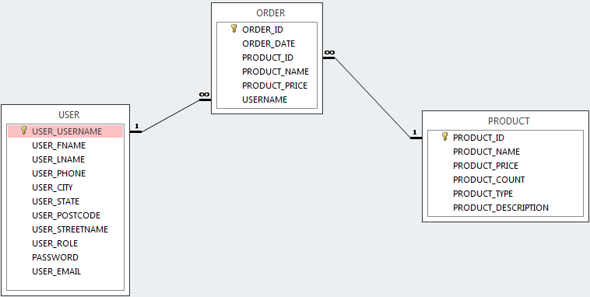
Entity Relationship Diagram (ERD)
ERD was created by using Microsoft Access 2013

